Slide 1

CS4225/CS5425 Big Data Systems for Data Science
Spark II: Advanced Topics
Ai Xin
School of Computing
National University of Singapore
aixin@comp.nus.edu.sg

Slide 2
Today’s Plan
Spark SQL and Catalyst Optimizer
Machine Learning with Mllib
Structured Streaming

Slide 3
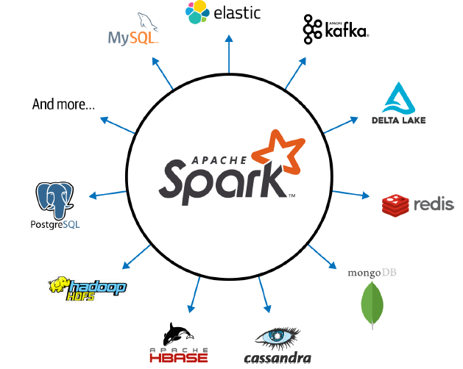
Spark Design Philosophy
Speed
Ease of use
Modularity
Extensibility

Slide 4
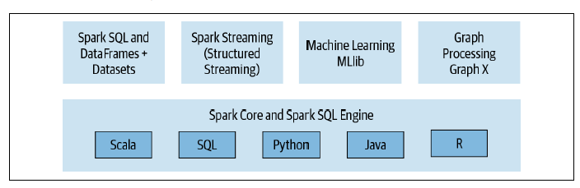
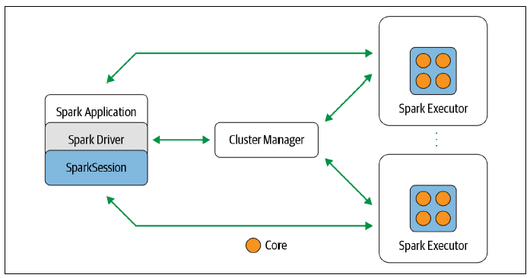
Spark: a unified stack for distributed execution

Slide 5
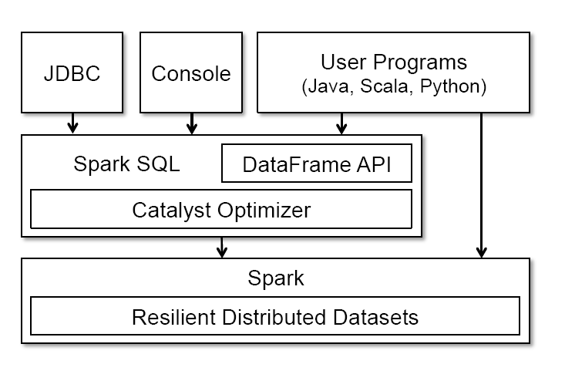
Spark SQL
Unifies Spark components and permits abstraction to DataFrames/Datasets in Java, Scala, Python, and R
Keep track of schema and support optimized relational operations
Notes:
The main abstraction in Spark SQL’s API is a DataFrame, a distributed
collection of rows with the same schema. A DataFrame
is equivalent to a table in a relational database, and can also be
manipulated in similar ways to the “native” distributed collections
in Spark (RDDs). Unlike RDDs, DataFrames keep track of their
schema and support various relational operations that lead to more
optimized execution.

Slide 6
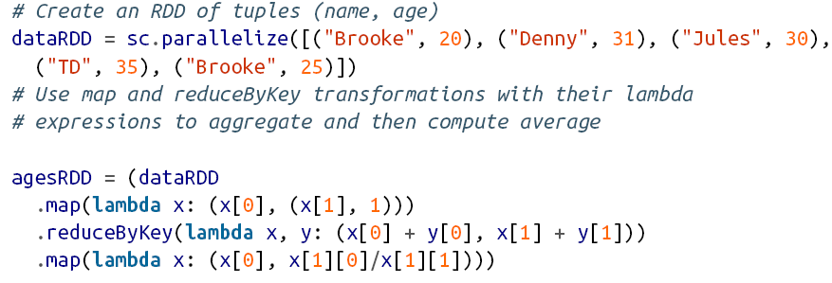
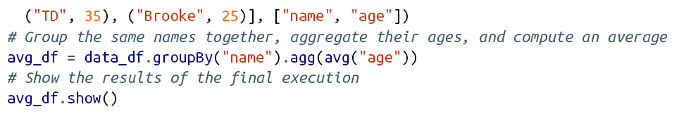
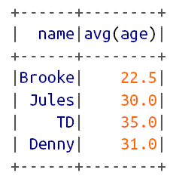
RDD vs. DataFrame
RDD
DataFrame
Notes:
Here, data_df is a DataFrame, and data_df(“name") is
an expression representing the name column. Expression objects
have many operators that return new expressions, including the usual
comparison operators (e.g., == for equality test, > for greater than)
and arithmetic ones (+, -, etc). They also support aggregates, such
as avg(“age"). All of these operators build up an abstract syntax
tree (AST) of the expression, which is then passed to Catalyst for
optimization. This is unlike the native Spark API that takes functions
containing arbitrary Scala/Java/Python code, which are then opaque
to the runtime engine.

Slide 7
RDD vs. DataFrame
RDD
Instruct Spark how to compute the query
The intention is completely opaque to Spark
Spark also does not understand the structure of the data in RDDs (which is arbitrary Python objects) or the semantics of user functions (which contain arbitrary code)
DataFrame
Tell Spark what to do, instead of How to do
The code is far more expressive as well as simpler
Using a domain specific language (DSL) similar to python pandas
Use high-level DSL operators to compose the query
Spark can inspect or parse this query and understand our intention, it can then optimize or arrange the operations for efficient execution

Slide 8
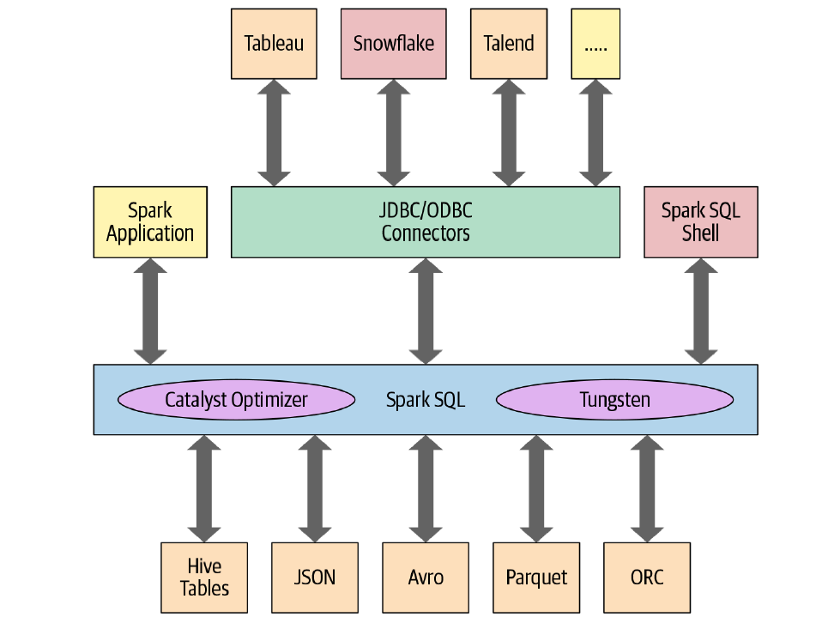
Spark SQL
Notes:
• Unifies Spark components and permits abstraction to DataFrames/Datasets in
Java, Scala, Python, and R, which simplifies working with structured data sets.
• Connects to the Apache Hive metastore and tables.
• Reads and writes structured data with a specific schema from structured file formats
(JSON, CSV, Text, Avro, Parquet, ORC, etc.) and converts data into temporary
tables.
• Offers an interactive Spark SQL shell for quick data exploration.
• Provides a bridge to (and from) external tools via standard database JDBC/
ODBC connectors.
• Generates optimized query plans and compact code for the JVM, for final
execution.

Slide 9
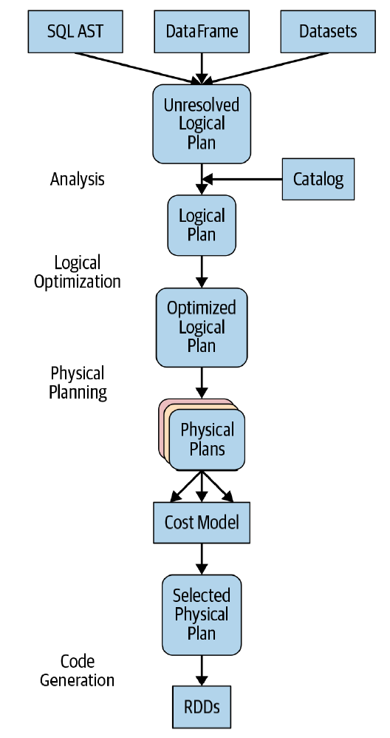
The Catalyst Optimizer
Takes a computational query and converts it into an execution plan through four transformational phases:
Analysis
Logical optimization
Physical planning
Code generation
A Spark computation’s four-phase journey
Notes:
Abstract syntax tree (AST)
https://www.linkedin.com/pulse/catalyst-tungsten-apache-sparks-speeding-engine-deepak-rajak
Phase 4: Code generation
Project Tungsten, which facilitates whole-stage code generation, plays a role here.
Just what is whole-stage code generation? It’s a physical query optimization phase that
collapses the whole query into a single function, getting rid of virtual function calls
and employing CPU registers for intermediate data. The second-generation Tungsten
engine, introduced in Spark 2.0, uses this approach to generate compact RDD code
for final execution. This streamlined strategy significantly improves CPU efficiency
and performance.

Slide 10
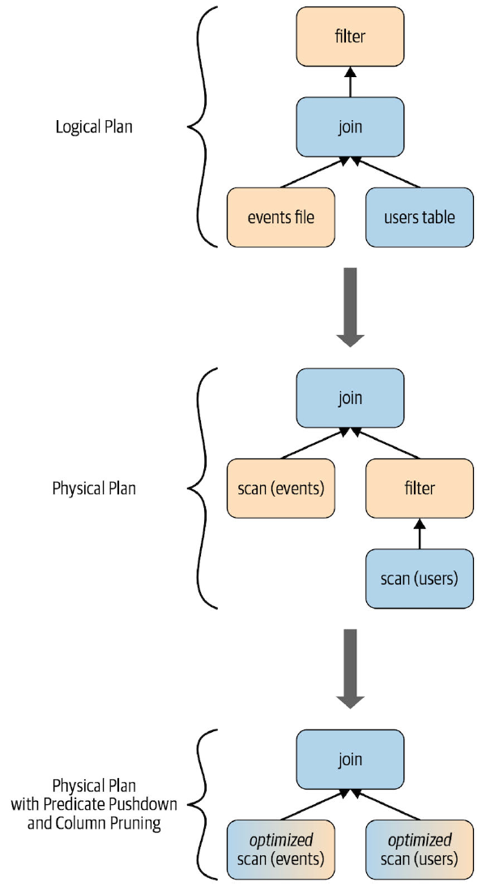
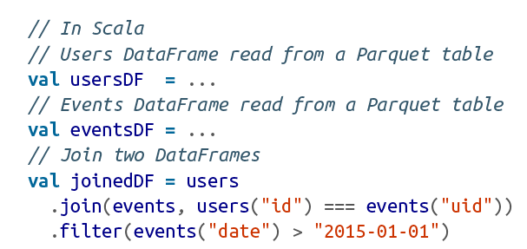

Slide 11
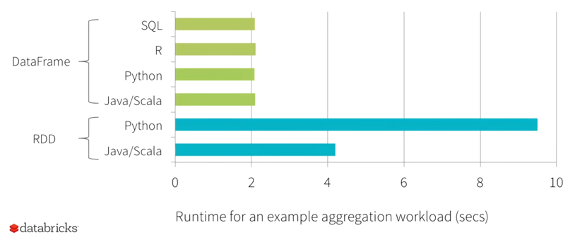
Benefit of Logical Plan
Performance Parity Across Languages
Source: https://youtu.be/VbSar607HM0

Slide 12
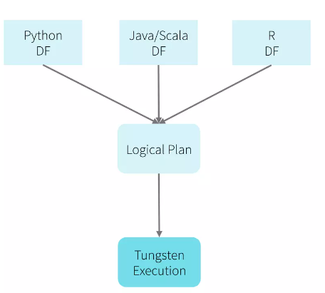
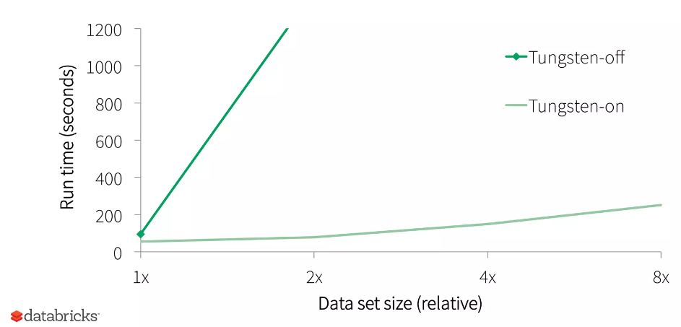
Project Tungsten
Objectives:
Substantially improve the memory and CPU efficiency of Spark applications
Push performance closer to the limits of modern hardware
How?
Memory Management and Binary Processing
Cache-aware computation
Code generation
Source: https://youtu.be/VbSar607HM0
Notes:
Project Tungsten in details
https://youtu.be/5ajs8EIPWGI

Slide 13
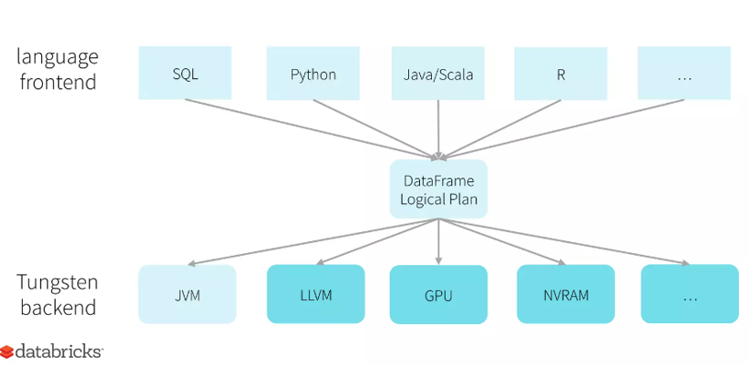
Unified API, One Engine, Automatically Optimized
Source: https://youtu.be/VbSar607HM0

Slide 14
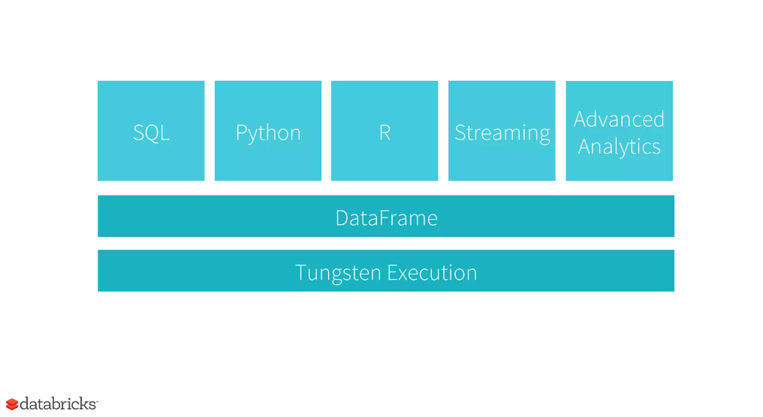
Source: https://youtu.be/VbSar607HM0

Slide 15
Today’s Plan
Spark SQL
Machine Learning with MLlib
Structured Streaming

Slide 16

Typical Machine Learning Pipeline
Preprocessing
Training
Testing
Evaluation
features
labels
X_{test}
ŷ_{test}
y_{test}
Process raw data
X_{train}
y_{train}
Evaluation
samples / observations

Slide 17
Spark MLLib: Simple Logistic Regression Model
from pyspark.ml.classification import LogisticRegression training = spark.read.format("libsvm").load("data/mllib/sample_libsvm_data.txt") lr = LogisticRegression(maxIter=10) lrModel = lr.fit(training) print("Coefficients: " + str(lrModel.coefficients)) print("Intercept: " + str(lrModel.intercept))

Slide 18

Pipelines
Idea: building complex pipeline out of simple building blocks (Note: scikit-learn pipelines are basically the same as Spark MLLib ones)

Slide 19
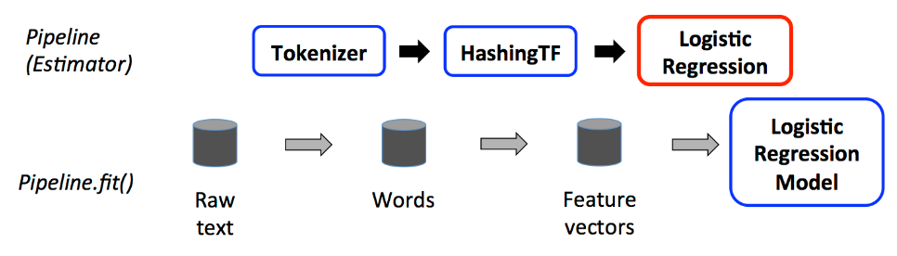
Pipelines
Idea: building complex pipeline out of simple building blocks: e.g. normalization, feature transformation, model fitting.
Why?
Better code reuse: without pipelines, we would repeat a lot of code, e.g. between the training and test pipelines, cross-validation, model variants, etc.
Easier to perform cross validation, and hyperparameter tuning.

Slide 20
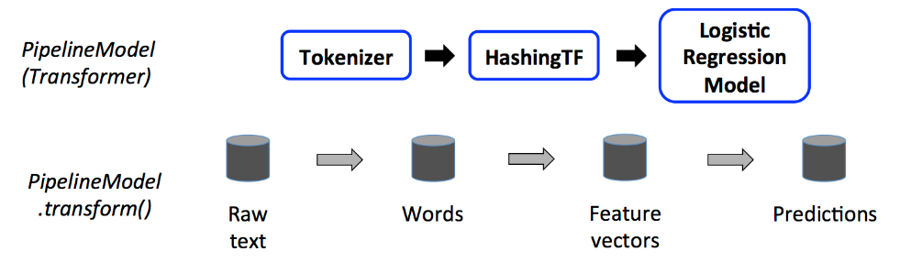
Building Blocks: Transformers
Transformers are for mapping DataFrames to DataFrames
Examples: one-hot encoding, tokenization
Specifically, a Transformer object has a transform() method, which performs its transformation
Generally, these transformers output a new DataFrame which append their result to the original DataFrame.
Similarly, a fitted model (e.g. logistic regression) is a Transformer that transforms a DataFrame into one with the predictions appended.
Transformers

Slide 21
Building Blocks: Estimator
Estimator is an algorithm which takes in data, and outputs a fitted model. For example, a learning algorithm (the LogisticRegression object) can be fit to data, producing the trained logistic regression model.
They have a fit() method, which returns a Transformer.
from pyspark.ml.classification import LogisticRegression training = spark.read.format("libsvm").load("data/mllib/sample_libsvm_data.txt") lr = LogisticRegression(maxIter=10) lrModel = lr.fit(training) print("Coefficients: " + str(lrModel.coefficients)) print("Intercept: " + str(lrModel.intercept))

Slide 22
Building Blocks: Estimator
Estimator is an algorithm which takes in data, and outputs a fitted model. For example, a learning algorithm (the LogisticRegression object) can be fit to data, producing the trained logistic regression model.
They have a fit() method, which returns a Transformer.
Estimator

Slide 23
Pipeline: Training Time
A pipeline chains together multiple Transformers and Estimators to form an ML workflow.
Pipeline is an Estimator. When Pipeline.fit() is called:
Starting from the beginning of the pipeline:
For Transformers, it calls transform()
For Estimators, it calls fit() to fit the data, then transform() on the fitted model

Slide 24
Pipeline: Test Time
The output of Pipeline.fit() is the estimated pipeline model (of type PipelineModel).
It is a transformer, and consists of a series of Transformers.
When its transform() is called, each stage’s transform() method is called.

Slide 25
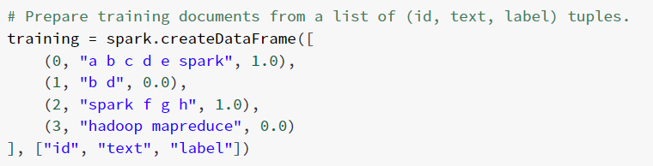
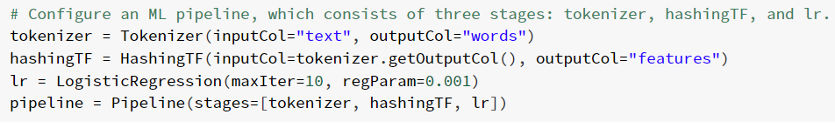
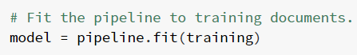
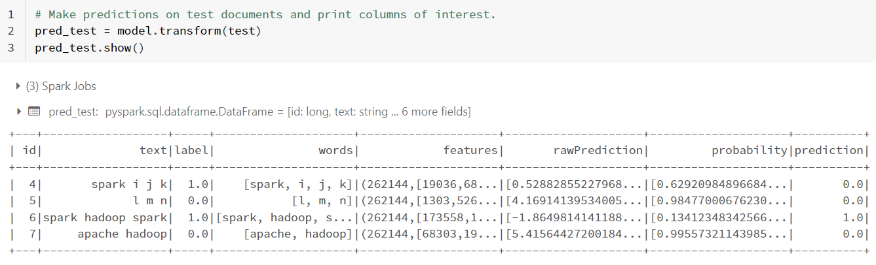
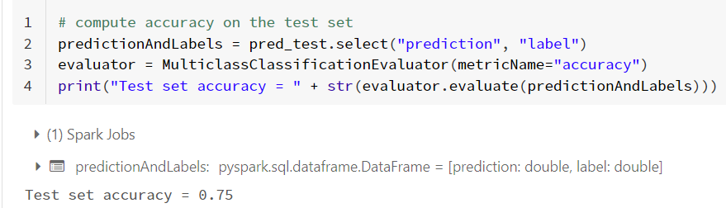
Demo_3: Machine Learning Pipeline

Slide 26
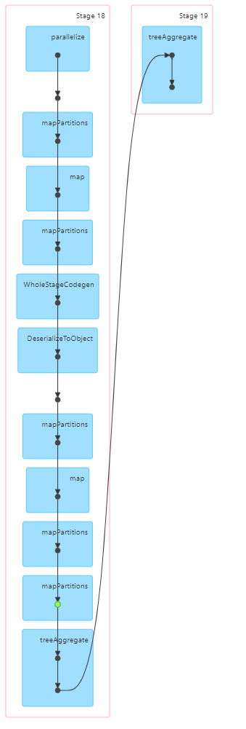
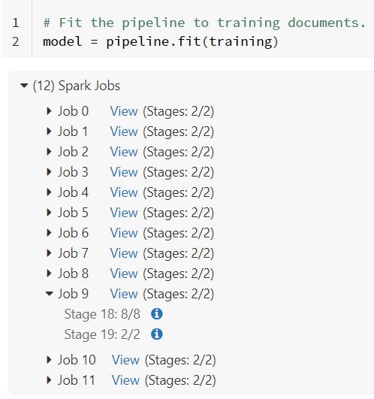
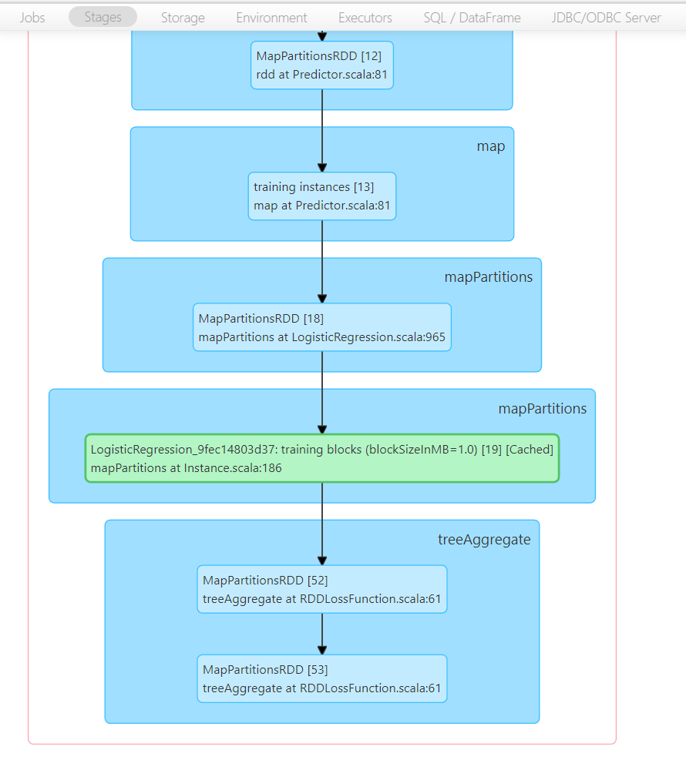

Slide 27
Today’s Plan
Spark SQL
Machine Learning with MLlib
Structured Streaming

Slide 28
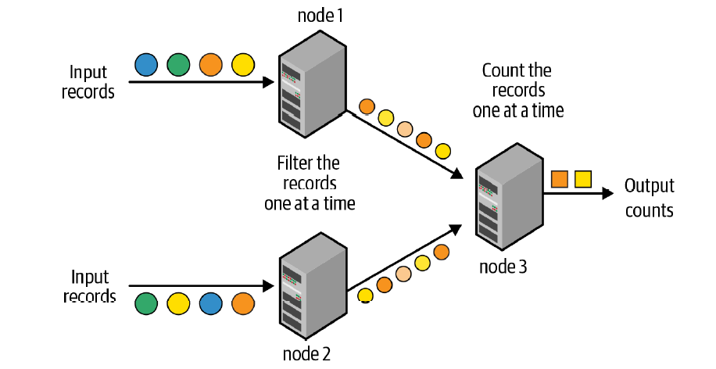
Traditional Model
Traditional record-at-a-time processing model
can achieve very low latencies (e.g. milliseconds)
not very efficient at recovering from
node failures
straggler nodes: nodes that are slower than others

Slide 29
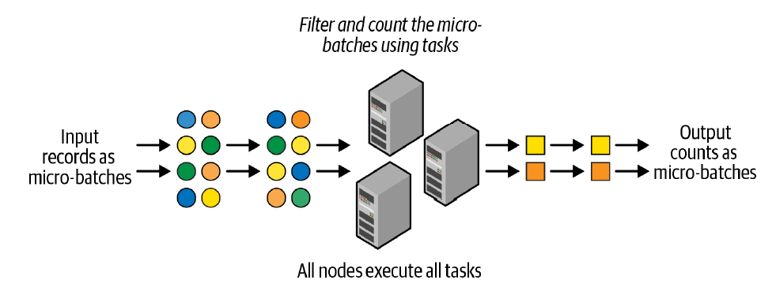
Micro-Batch Stream Processing
Structured Streaming uses a micro-batch processing model
divides the data from the input stream into micro batches
each batch is processed in the Spark cluster in a distributed manner
small deterministic tasks generate the output in micro-batches
Advantages over traditional model
quickly and efficiently recover from failures and straggler executors
deterministic nature ensures end-to-end exactly-once processing guarantees
Disadvantages: latencies of a few seconds
OK for many applications
Application may incur more than a few
seconds delay in other parts of pipeline

Slide 30
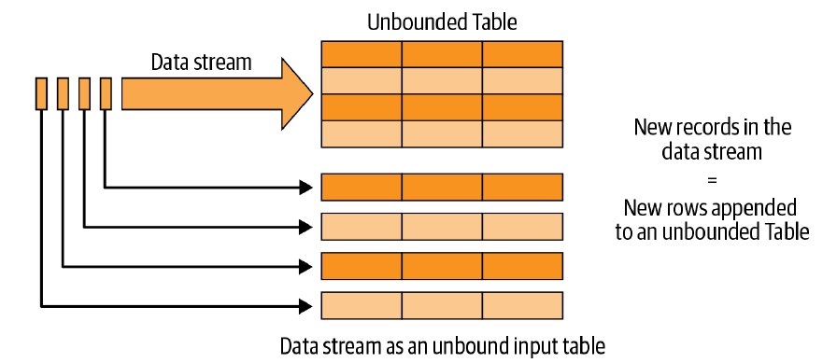
The Philosophy of Structured Streaming
For developers, writing stream processing pipelines should be as easy as writing batch pipelines.
A single, unified programming model and interface for batch and stream processing
A broader definition of stream processing
The Structured Streaming programming model: data stream as an unbounded table
Notes:
Thinking of the data streams as tables not only makes it easier to conceptualize the
logical computations on the data, but also makes it easier to express them in code.
Since Spark’s DataFrame is a programmatic representation of a table, you can use the
DataFrame API to express your computations on streaming data. All you need to do
is define an input DataFrame (i.e., the input table) from a streaming data source, and
then you apply operations on the DataFrame in the same way as you would on a
DataFrame defined on a batch source.

Slide 31
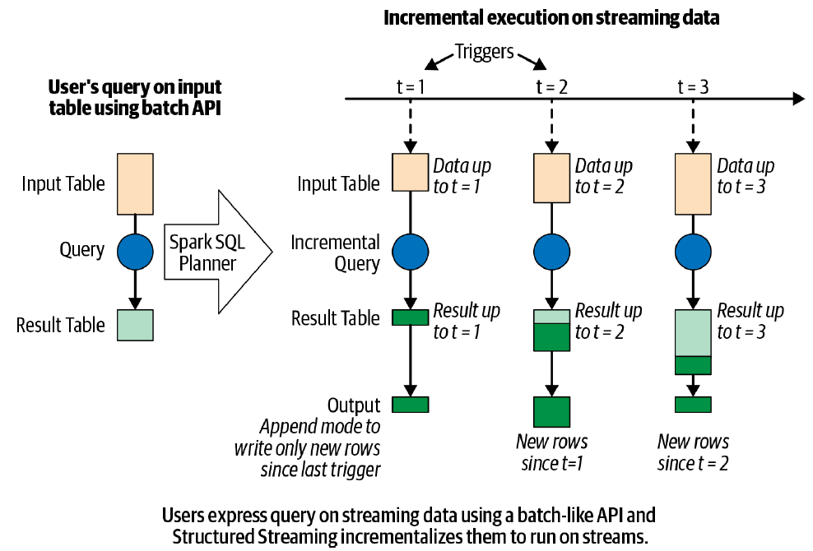
The Structured Streaming processing model

Slide 32
Five Steps to Define a Streaming Query
Step 1: Define input sources
Step 2: Transform data
Step 3: Define output sink and output mode
Output writing details (where and how to write the output)
Processing details (how to process data and how to recover from failures)
Step 4: Specify processing details
Triggering details: when to trigger the discovery and processing of newly available streaming data.
Checkpoint Location: store the streaming query process info for failure recovery
Step 5: Start the query

Slide 33
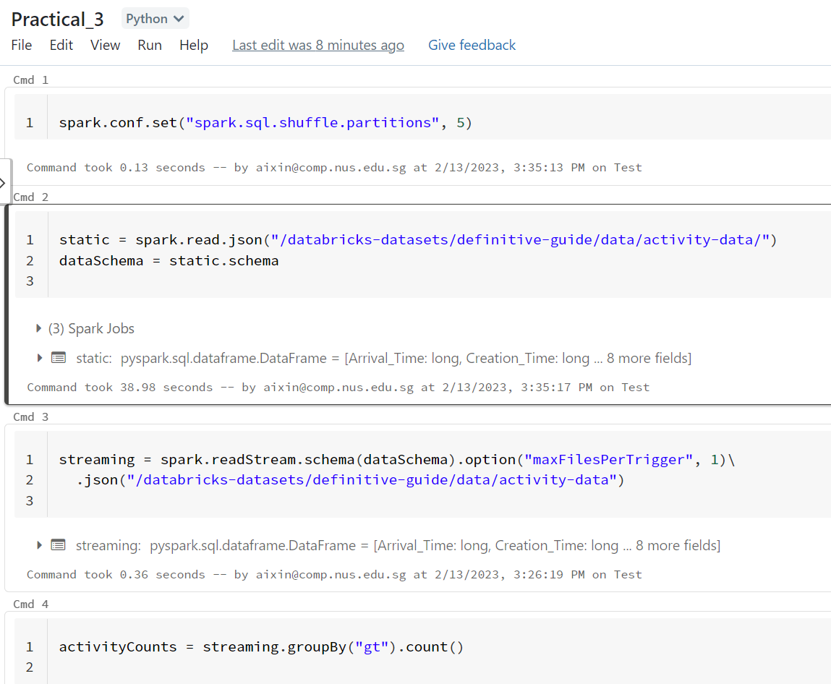
Practical_3: a simple streaming example
Source: https://github.com/databricks/Spark-The-Definitive-Guide

Slide 34
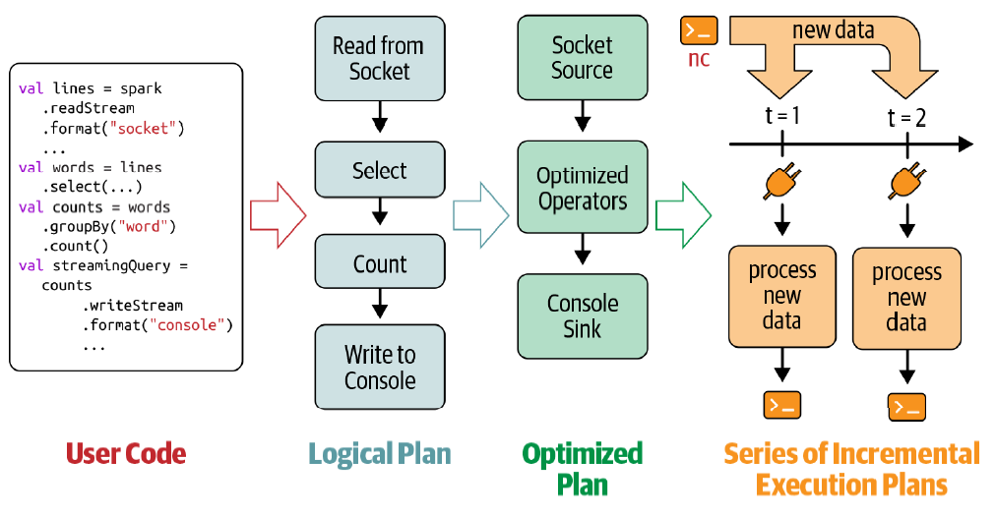
Incremental execution of streaming queries

Slide 35
Data Transformation
Stateless Transformation
Process each row individually without needing any information from previous rows
Projection operations: select(), explode(), map(), flatMap()
Selection operations: filter(), where()
Stateful Transformation
A simple example: DataFrame.groupBy().count()
In every micro-batch, the incremental plan adds the count of new records to the previous count generated by the previous micro-batch
The partial count communicated between plans is the state
The state is maintained in the memory of the Spark executors and is checkpointed to the configured location to tolerate failures.

Slide 36
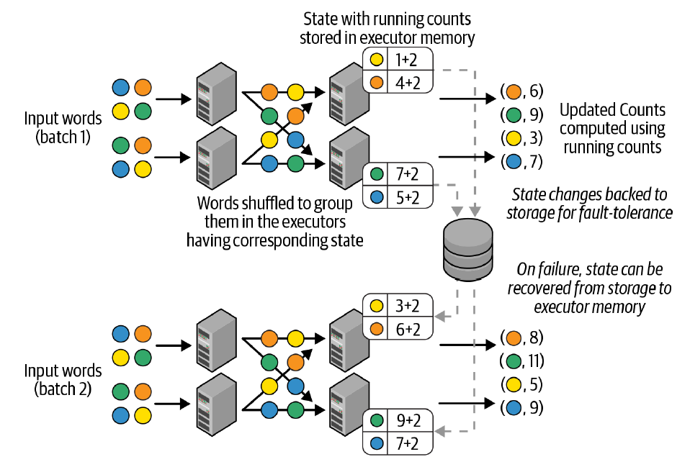
Distributed state management in Structured Streaming

Slide 37
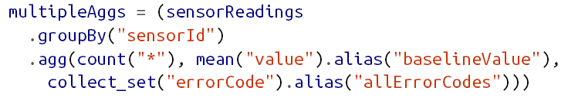
Stateful Streaming Aggregations
Aggregations Not Based on Time
Global aggregations
Grouped aggregations
All built-in aggregation functions in DataFrames are supported
sum(), mean(), stddev(), countDistinct(), collect_set(), approx_count_distinct(), and etc.
You can apply multiple aggregation functions to be computed together
Notes:
You cannot use direct aggregation operations like Data
Frame.count() and Dataset.reduce() on streaming Data‐
Frames. This is because, for static DataFrames, these
operations immediately return the final computed aggregates,
whereas for streaming DataFrames the aggregates have to be
continuously updated. Therefore, you have to always use Data
Frame.groupBy() or Dataset.groupByKey() for aggregations
on streaming DataFrames.

Slide 38
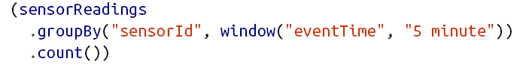
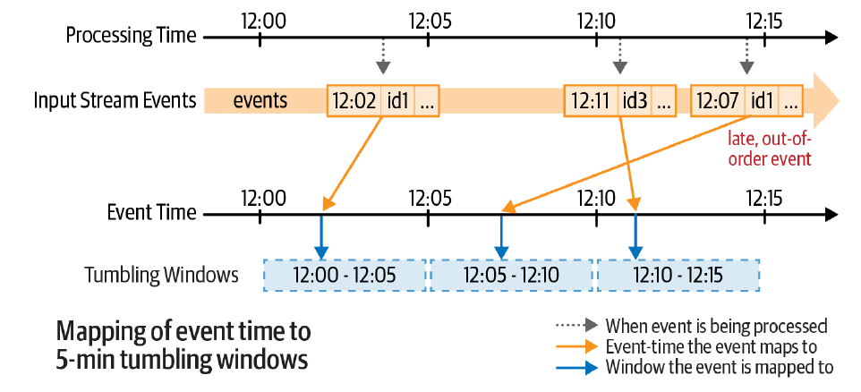
Stateful Streaming Aggregations
Aggregations with Event-Time Windows

Slide 39
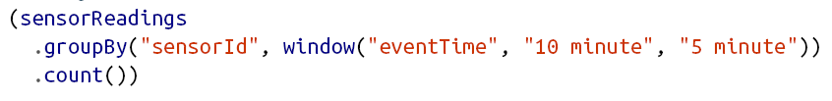
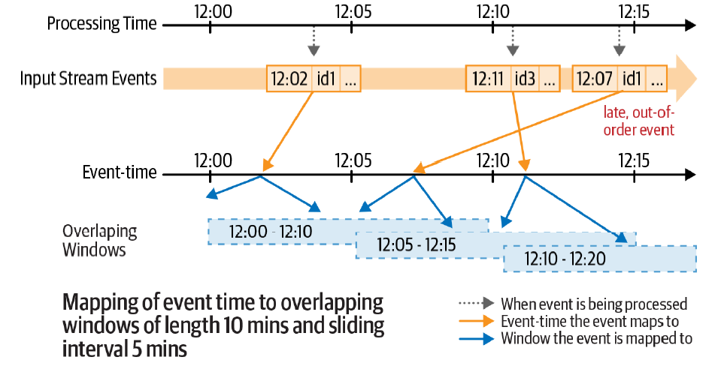

Slide 40
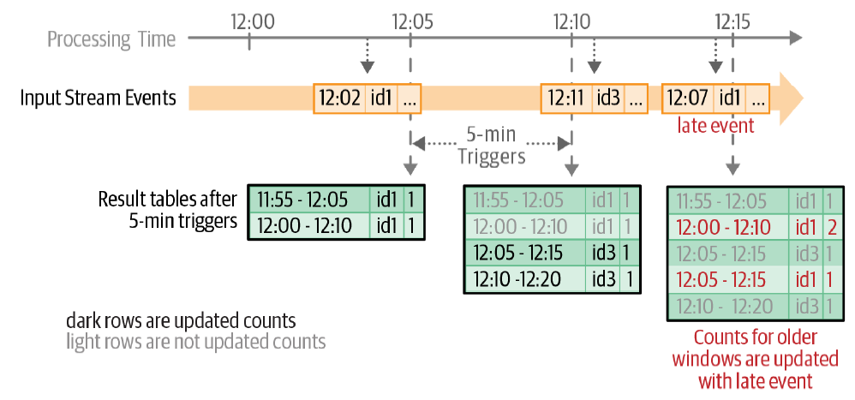
Updated counts in the result table after each five-minute trigger

Slide 41
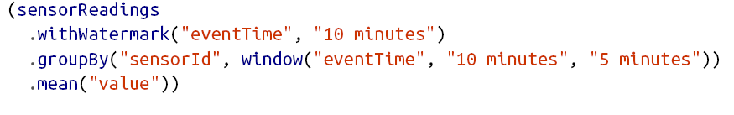
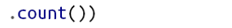
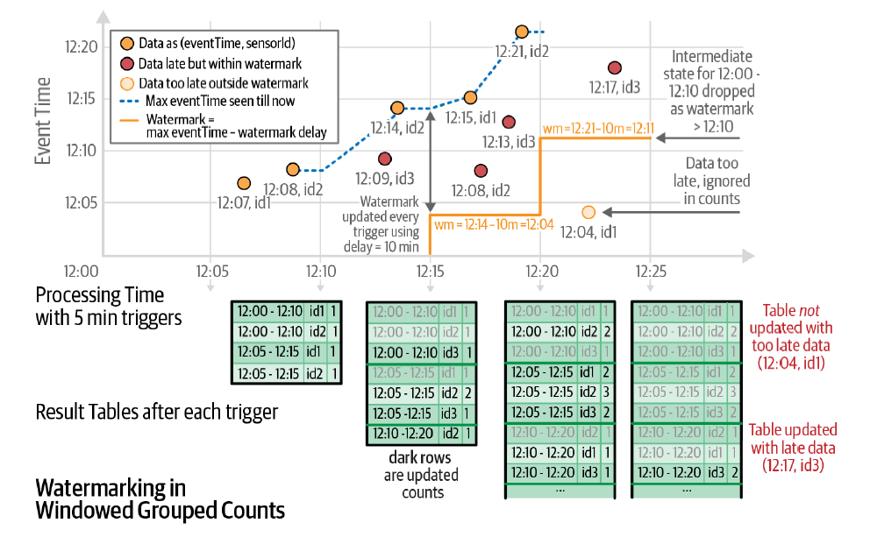
Handling Late Data with Watermarks

Slide 42
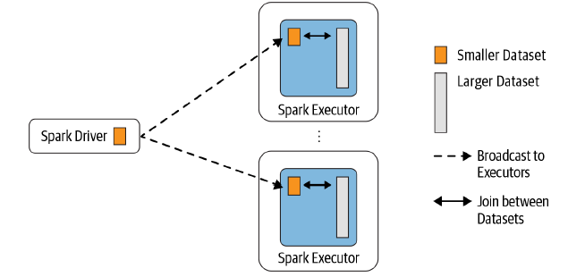
Spark Join
Broadcast Hash Join (a.k.a. map-side-only join)
the smaller data set is broadcast to all executors

Slide 43
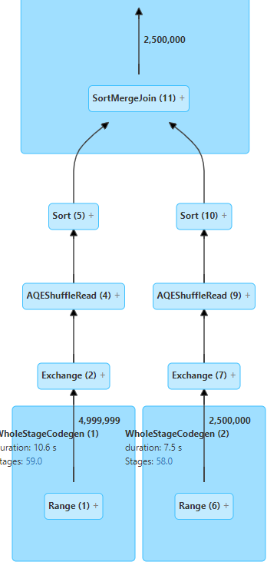
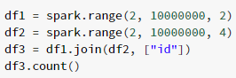
Spark Join
Shuffle Sort Merge Join
an efficient way to merge two large data sets over a common key that is sortable, unique, and can be assigned to or stored in the same partition

Slide 44
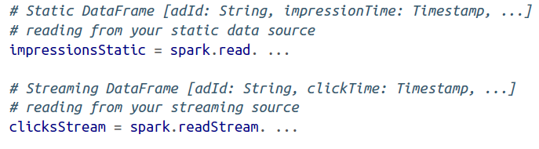
Streaming Join
Stream-Static Join
Stateless Operations, no need watermarking
Cache the static DataFrame to speed up the repeatedly reads

Slide 45
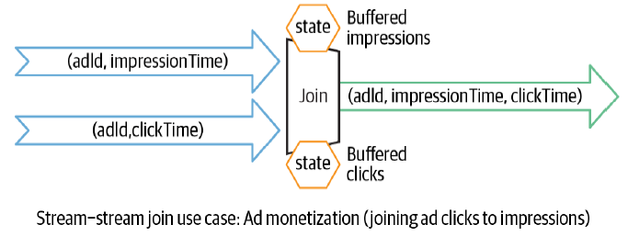
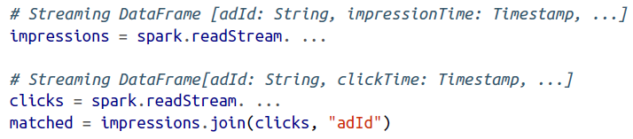
Streaming Join
Stream-Stream join
Finding the matching events from the two buffered streams

Slide 46
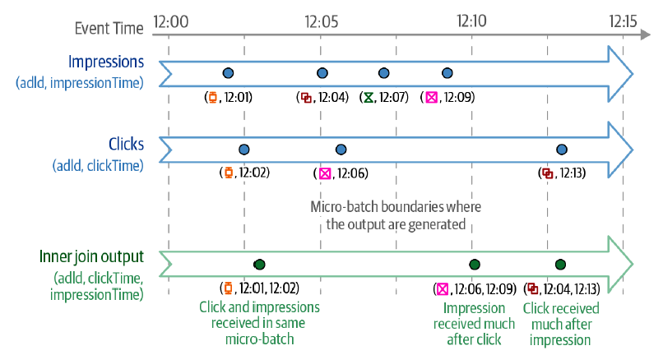
Inner joins with optional watermarking

Slide 47
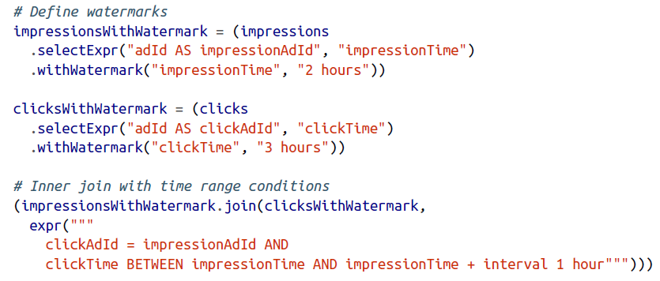

3 hours late click + up to 1 hour delay between the impression and click

Slide 48


Outer joins with watermarking
For correct outer join results and state cleanup, the watermarking and event-time constraints must be specified.
for generating the NULL results, the engine must know when an event is not going to match with anything else in the future

Slide 49
Performance Tuning
Besides tuning Spark SQL engine, a few other considerations
Cluster resource provisioning appropriately to run 24/7
Number of partitions for shuffles to be set much lower than batch queries
Setting source rate limits for stability
Multiple streaming queries in the same Spark application

Slide 50
Acknowledgements
CS4225 slides by He Bingsheng and Bryan Hooi
Jules S. Damji, Brooke Wenig, Tathagata Das & Denny Lee, “Learning Spark: Lightning-Fast Data Analytics”
Bill Chambers, Matei Zaharia, “Spark: The Definitive Guide”
Spark SQL: Relational Data Processing in Spark, SIGMOD’15
https://spark.apache.org/docs/latest/ml-pipeline.html

